Slide 1

Global Video Game Sales
Anna Li

Slide 2
Purpose
Examine trends in video game sales across regions to maximize future revenue.
Higher emphasis on exploratory data analysis and visualizations.
Target Audience Examples
Video game designers (Focus of presentation)
Utilize popular trends for wider appeal
Video game publishers
Maximize return on investment
Notes:
Designers want to know what characteristics are common in popular games, what is more likely to sell and how their vision will be accepted by the public
Publishers such as Nintendo, Electronic Arts can use this information to choose which games to provide funding towards, bigger return on investment

Slide 3


Data - Kaggle
Columns:
NA sales (mil)
EU sales (mil)
JP sales (mil)
Other sales (mil)
Global sales (mil)
Genre
Publisher
# of Platforms
Years of Release

Slide 4
Data Cleaning
Merging two datasets
General cleaning
- dropped duplicates, majority null values columns/rows, irrelevant columns
Duplicates
- same title with different sale values > sum
- same title with different years of release > mean
Notes:
Merging both datasets into one dataframe: The two datasets were merged on game name.
Column cleaning: Duplicates, columns with too many null values, and irrelevant columns such as RAWG Database ID were removed.
General cleaning: Rows that contained null values were dropped.

Slide 5
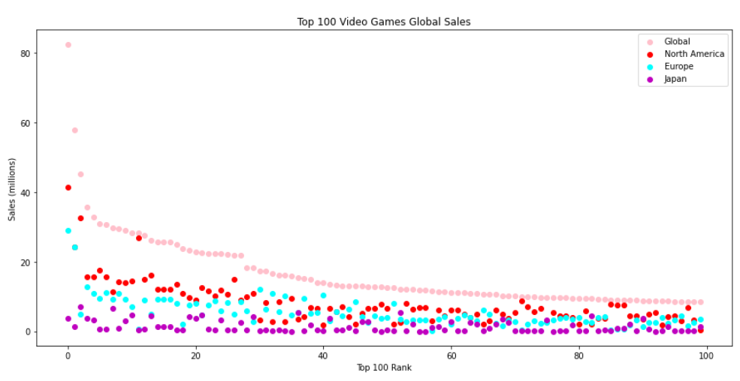
Exploratory Data Analysis - Sales
Notes:
This is the distribution of sales between the different regions based on the rankings of the top 100 globally sold games. A majority of the global sales are made up of sales from North America. Almost every game has the highest sales in North America in comparison to Europe and Japan.

Slide 6
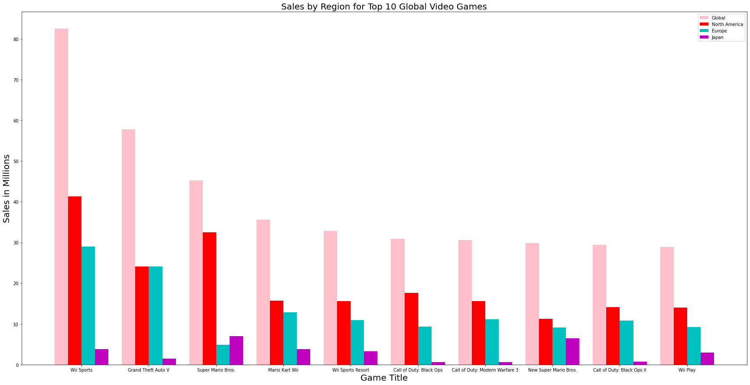
Exploratory Data Analysis - Sales
Notes:
Here the sales are shown for the top 10 globally ranked video games. North America and Europe generally have similar trends in game sales and ranking. They account for a majority of the sales globally. Japan's trends are extremely unique. Even for globally popular games such as Grand Theft Auto V and Call of Duty: Black Ops, Japan has very low sales. Why is this? One reason I can think of from looking at the titles.
Publisher : (go through titles and point out Nintendo games and how they have high sales)
Let’s explore more into this

Slide 7
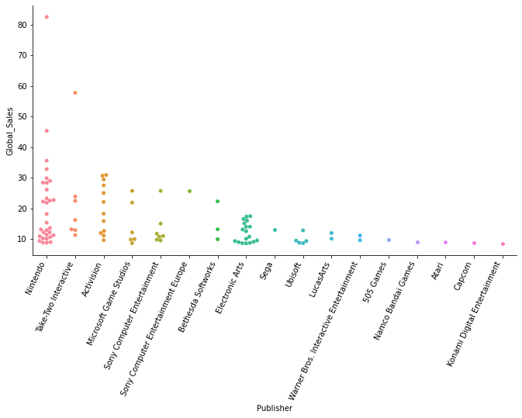
Exploratory Data Analysis - Publisher
Publisher Distribution in Top 100 Global Games
Rankings:
Nintendo
Take-Two Interactive
Activision
Microsoft Game Studios
Sony
Sony Europe
Bethesda
Electronic Arts
Sega
Ubisoft

Slide 8
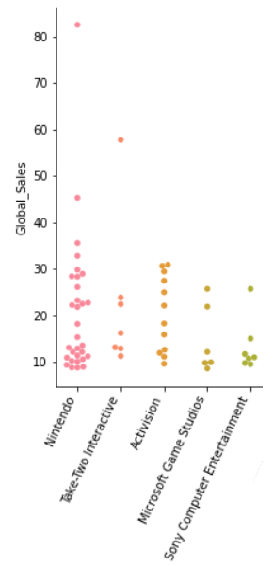
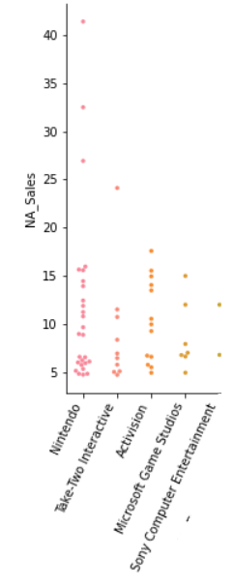
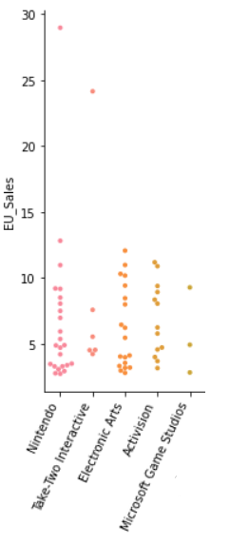
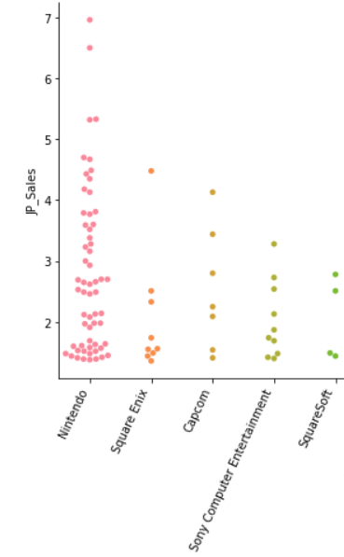
Exploratory Data Analysis - Publisher
Global
North America
Europe
Japan

Slide 9
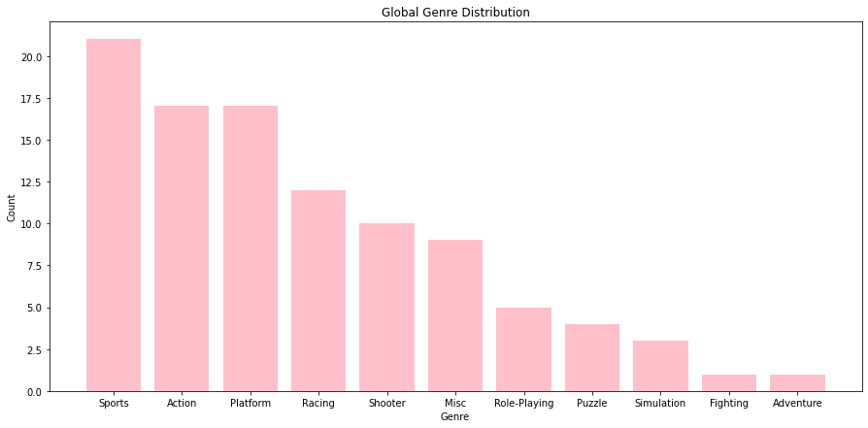
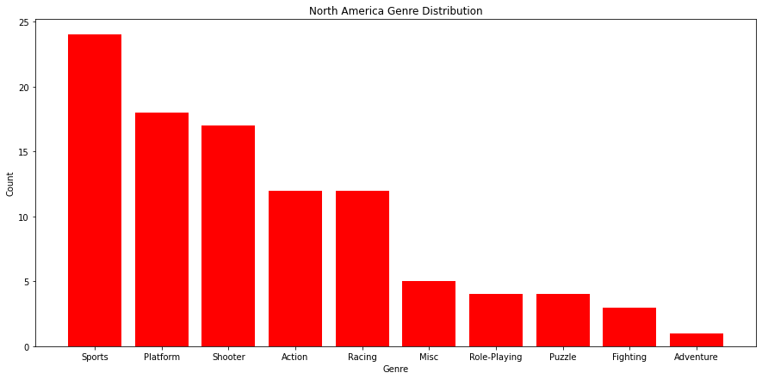
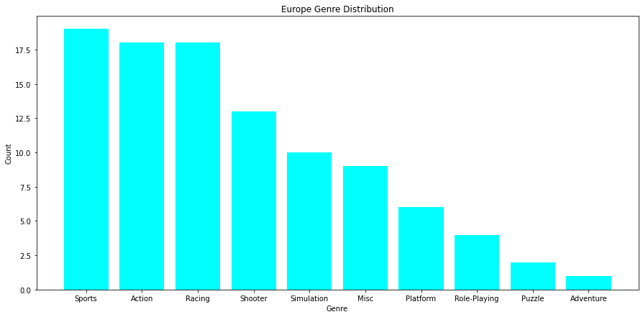
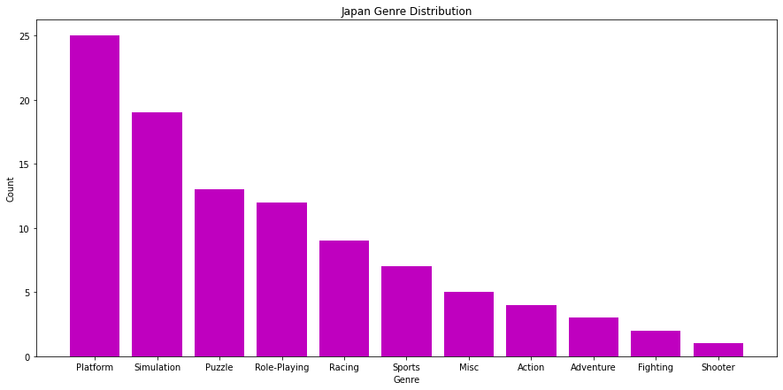
Exploratory Data Analysis - Genre

Slide 10
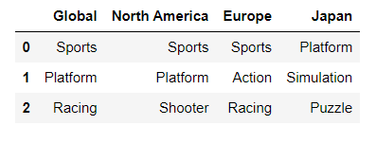
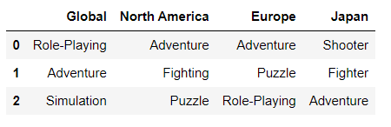
Exploratory Data Analysis - Genre
Top 3 Genres
Bottom 3 Genres

Slide 11
Preprocessing and Training
Converted categorical columns into numerical
1. Release Year > Years of Release
2. Platforms List > # of Platforms
3. Genre > One-hot encoding
Train-Test Split
70/30
Standardization
Standard Scaler on training set

Slide 12
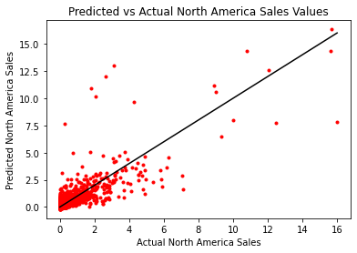
Multiple Linear Regression Models
North America Sales
R-Squared : 0.685
P-Value: 0.00
MAE : 0.34

Slide 13
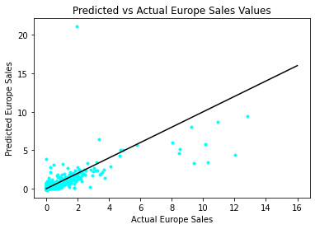
Multiple Linear Regression Models
Europe Sales
R-Squared : 0.816
P-Value: 0.00
MAE : 0.15

Slide 14
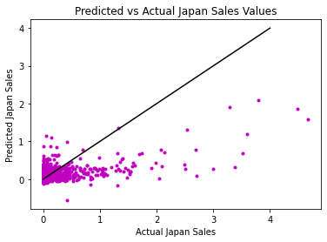
Multiple Linear Regression Models
Japan Sales
R-Squared : 0.249
P-Value: > 0.05
MAE : 0.15

Slide 15
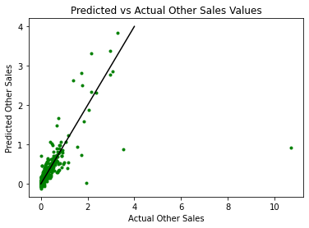
Multiple Linear Regression Models
Other Regions Sales
R-Squared : 0.778
P-Value: 0.00
MAE : 0.05

Slide 16
Findings and Conclusion
Sales
North America > Europe > Japan
Publisher
Nintendo > Take-Two Interactive > Activision > Microsoft
Japan: Sony
Europe: Electronic Arts
Genre
Sports > Platform >= Action > Racing
Models
Europe > Other Regions > North America > Japan

Slide 17
Future Improvements
Japan Sales
- Data was not well suited to predict Japan’s sales
- Japan’s trends did not follow that of other regions
Group k-Fold Cross Validation
- Data is split in a way so that the same group will not appear in different folds
- Can increase accuracy of the models

Slide 18
Questions?

